Slide 1

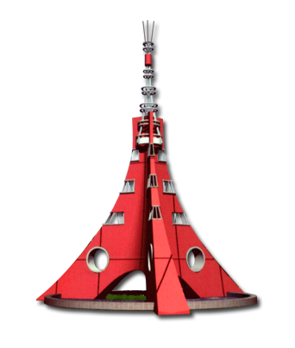


WELCOME TO VISAKHAPATNAM STEELPLANT
A PROJECT ON COMPUTERISED RAWMATERIALS MANAGEMENT SYSTEM USING HTML

Slide 2

In Partial Fulfillment for Trade Apprenticeship Training
“ COMPUTER OPERATOR AND PROGRAMMING ASSISTANT”
(COPA)
Under the guidance of Shri. Dipankar Dey, Dy.Manager (Trg).
Submitted by K.ESWARUDU TRAINEE NO: 052544

Slide 3
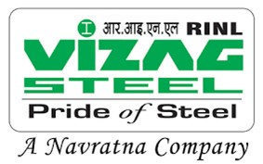
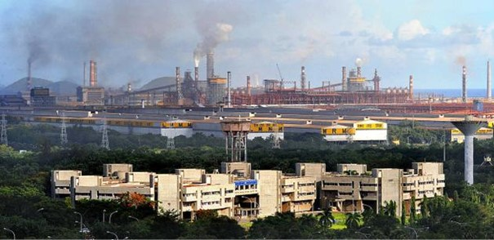
VIEW OF ADMIN BUILDING AND STEELPLANT

Slide 4
INTRODUCTION
“ A PROJECT ON COMPUTERISED RAWMATERIALS MANAGEMENT SYSTEM USING HTML “
RAW MATERIALS DEPARTMENT
(RMD)

Slide 5
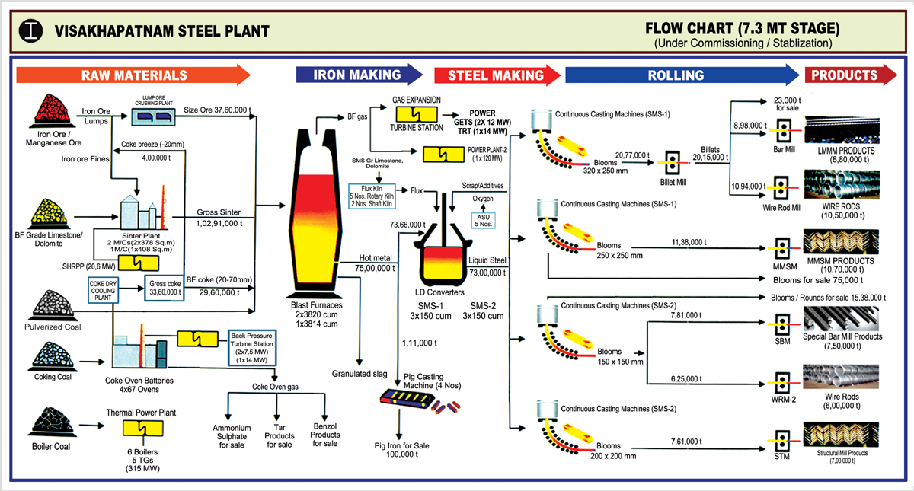
FLOW CHART

Slide 6
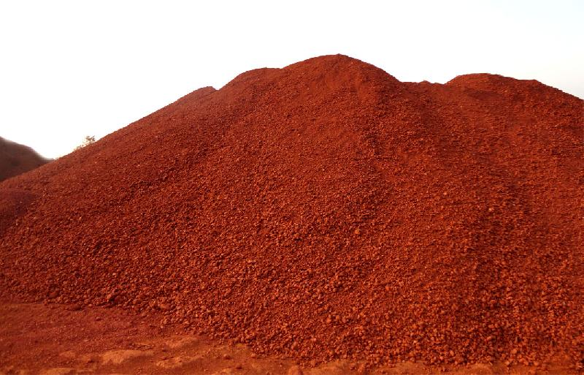
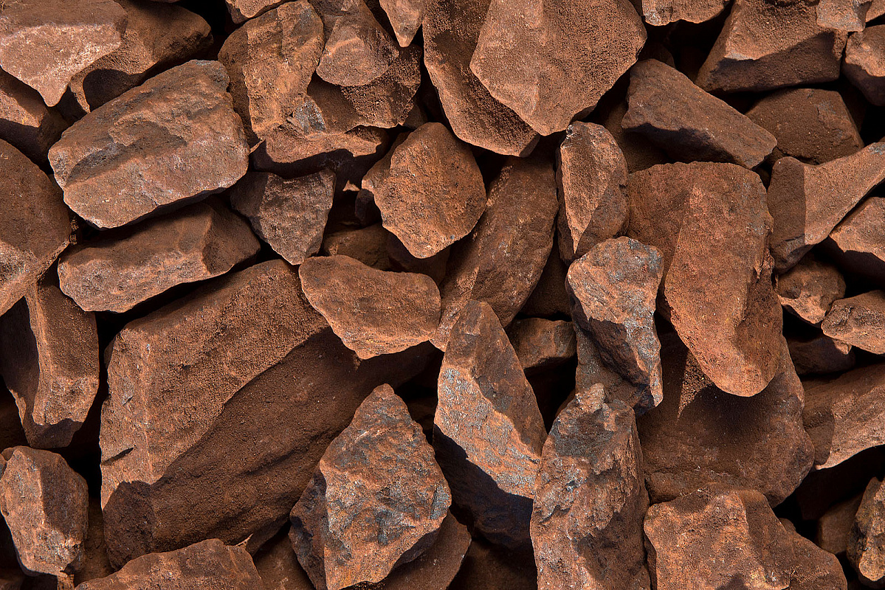
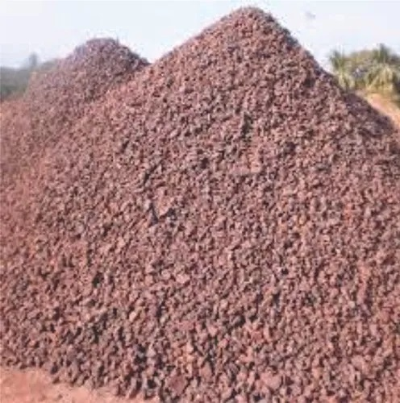
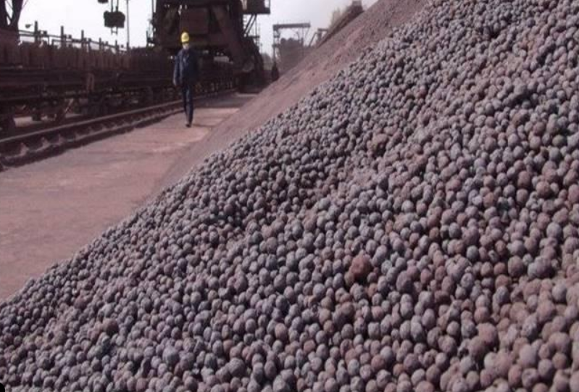
Types of Iron Ore :-
a) Iron Ore Fines => (Fe-62-64%)
Size: -10 mm
Sources: NMDC Bailadila Mines
b) Iron Ore Lump => (Fe-62-64%)
Size: 10 -140 mm
Sources: NMDC Bailadila Mines
c) CLO (Calibrated Lump Ore) => (Fe-62-64%)
Size: 10 -140 mm
Sources: NMDC Bailadila Mines
d) Iron Ore Pellets => (Fe-62-64%)
Size: 10 -140 mm
Sources: NMDC Donimalai Pellets,
KIOCL.

Slide 7
Type of Coals:
a) Non-Coking Coal
i) Imported Hard Coking Coal
ii) Imported Soft Coking Coal
iii) PCI (Pulverized Coal Injection)
Imported Hard Coking Coal: (Brand-wise) PeakDown, Goonyella, Moranbah North,
Cambaria Creek, Benga HCC.
Sources: Australia, USA, Mozambique.
Imported Soft Coking Coal : (Brand-wise)
Kestrel, Moura Soft, Black Water Soft, Blue Diamond Soft.
Sources: Australia, Newzealand.
b) Coking Coal
i) Boiler Coal : Talcher,BOCM,Singareni.
ii) Medium Coking Coal:
iii) Prime Coking Coal:
iv) Imported Boiler Coal: Mozambique.

Slide 8
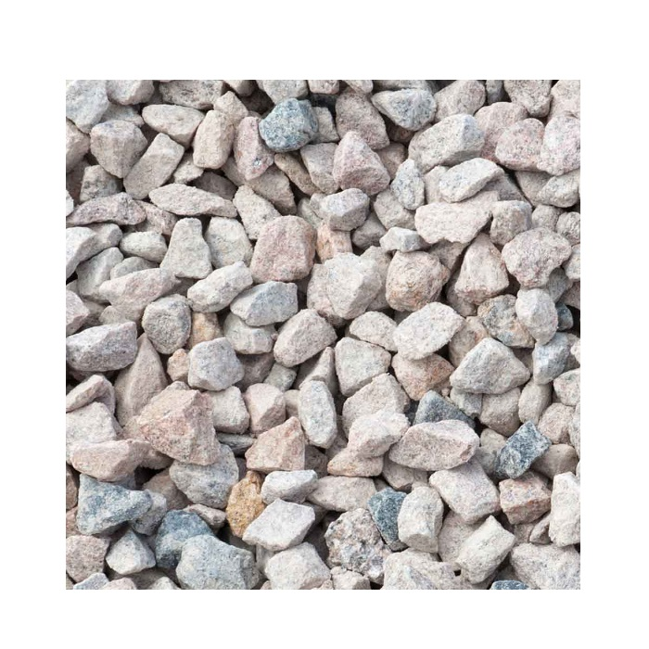
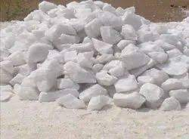
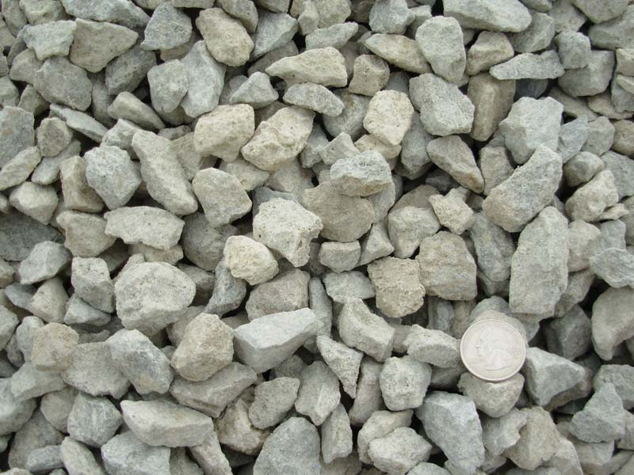
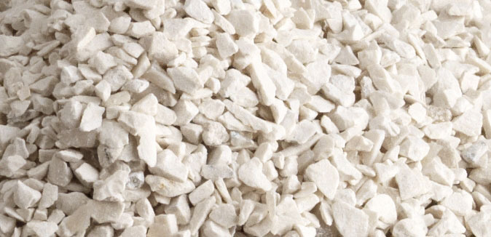
Type of Fluxes:
a) Dolomite
i) BF Dolomite:
Sources: Captive mines(Madharam), Private Party
ii) SMS Dolomite:
Sources: Captive mines(Madharam), Private Party
b) Limestone
i) BF Limestone
Sources: Captive mines(Jaggayapeta)
ii) SMS Limestone
Sources: UAE,Dubai

Slide 9
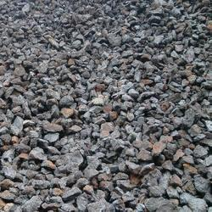
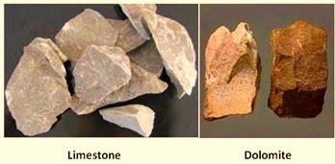
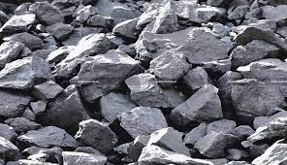
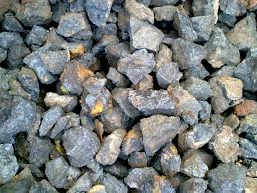
RAW MATERIALS
IRON ORE FINES
PELLETS
MN ORE FINES
LIMESTONE & DOLOMITE
IRON ORE LUMP
BF LIME STONE
MANGANEESE ORE LUMP

Slide 10
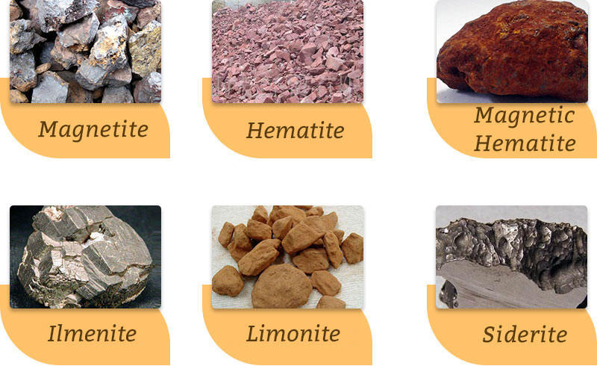
FLUXES

Slide 11
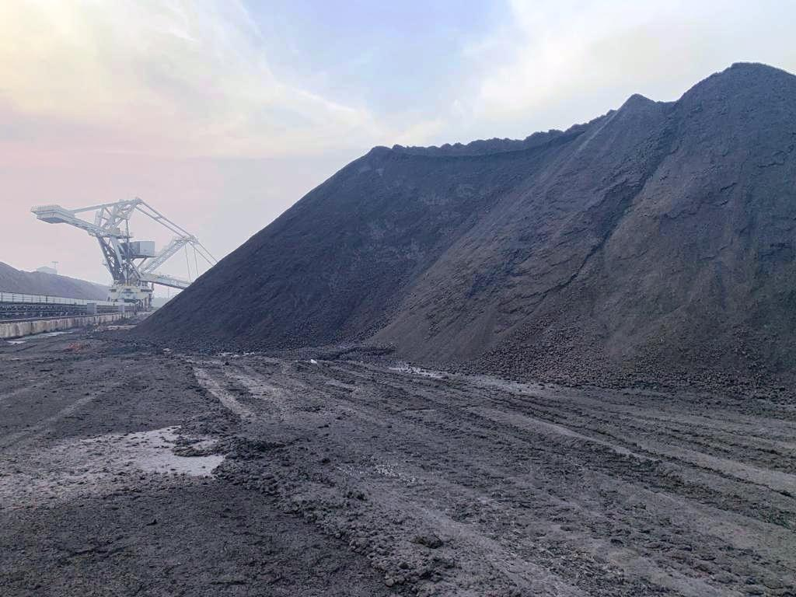
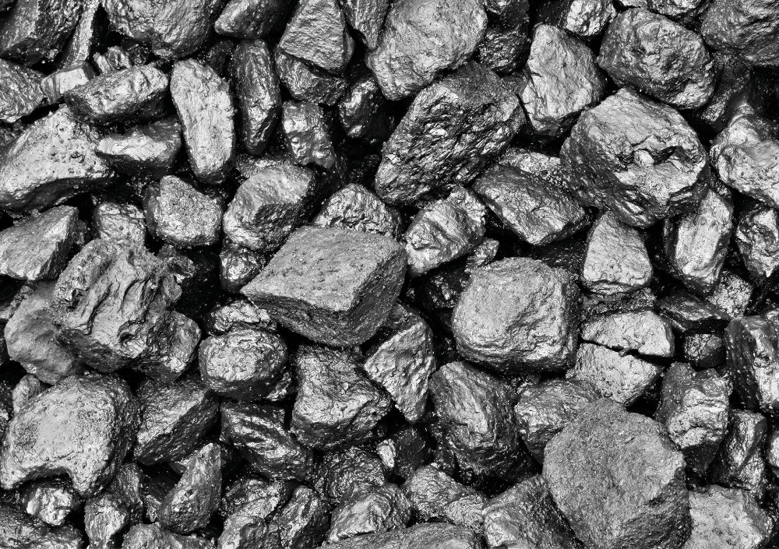
COALS
Coking Coal
Thermal Coal

Slide 12
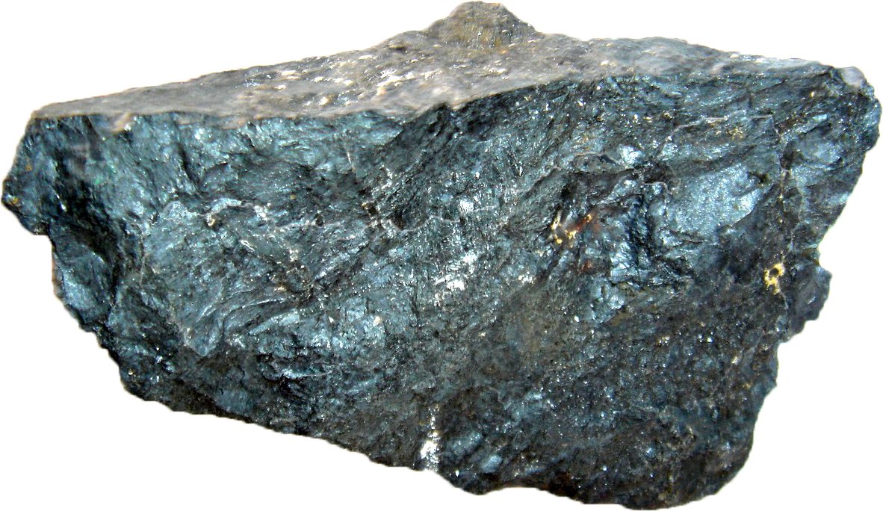
SPECIFICATIONS OF IRON ORE
Chemical Composition
%Fe → 63 - 65% Min
%Al2O3 → 3.0% Max
%SiO2 → 3.0 Max
Phosphorus → 0.06 Max
Sulfur → 0.02 Max
Iron Ores
Iron Ores are rocks and minerals from which metallic iron can be economically extracted. The ores are usually rich in iron oxides and vary in color from dark gray, bright yellow, deep purple, to rusty red. The iron itself is usually found in the form of magnetic (Fe3O4), Hematite (Fe2O3).

Slide 13
Hot Metal Statistics:
YEAR | PLAN | ACTUAL | FULFILLMENT
2018-19 | 6.2 MT | 5.77 MT | 93 %
2019-20 | 6.5 MT | 5.16 MT | 79 %
2020-21 | 6.1 MT | 4.68 MT | 77 %
2021-22 | 6.25MT | 5.77 MT | 92 %
2022-23 (till July’22) | 6.1 MT | *1.38MT | -
Note: * Up to Apr-Jul’22

Slide 14
Liquid Steel Statistics:
YEAR | PLAN | ACTUAL | FULFILLMENT
2018-19 | 6.1 MT | 5.52 MT | 90 %
2019-20 | 6.4 MT | 4.98 MT | 78 %
2020-21 | 5.9 MT | 4.49 MT | 76 %
2021-22 | 6.10 MT | 5.51 MT | 90 %
2022-23 (till July’22) | 6.3 MT | *1.59 MT | -
Note: * Up to Apr-Jul’22

Slide 15
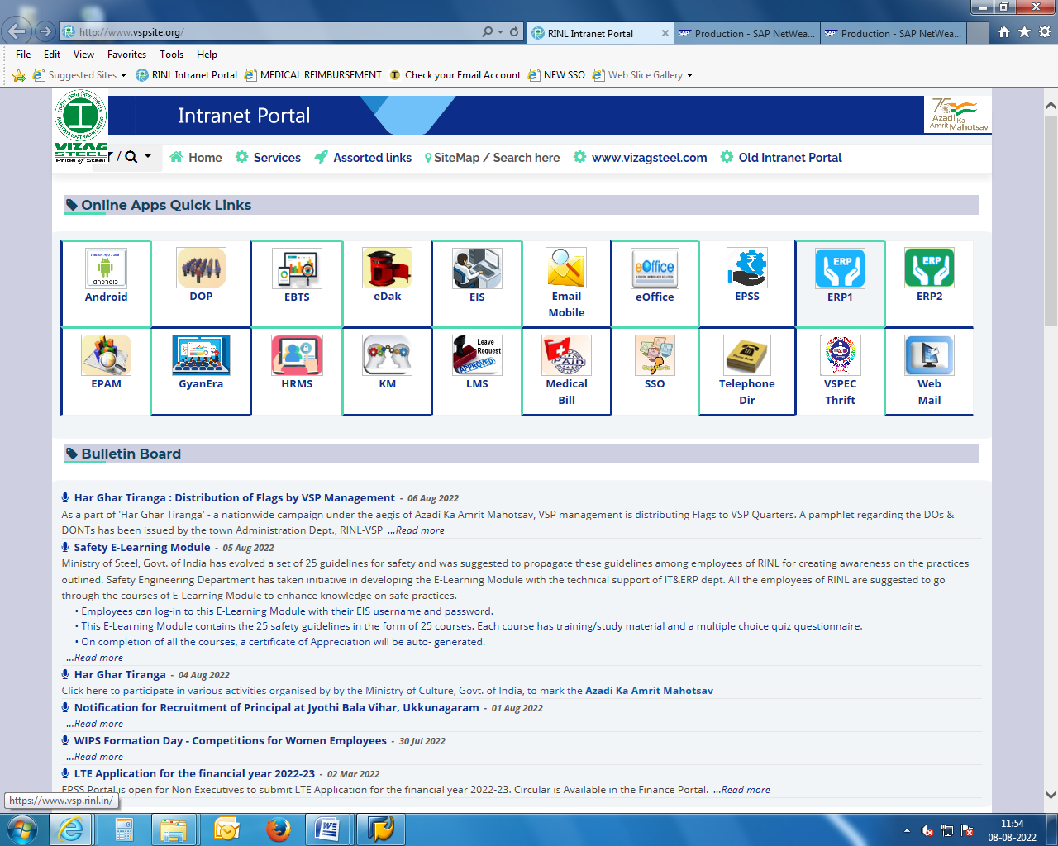
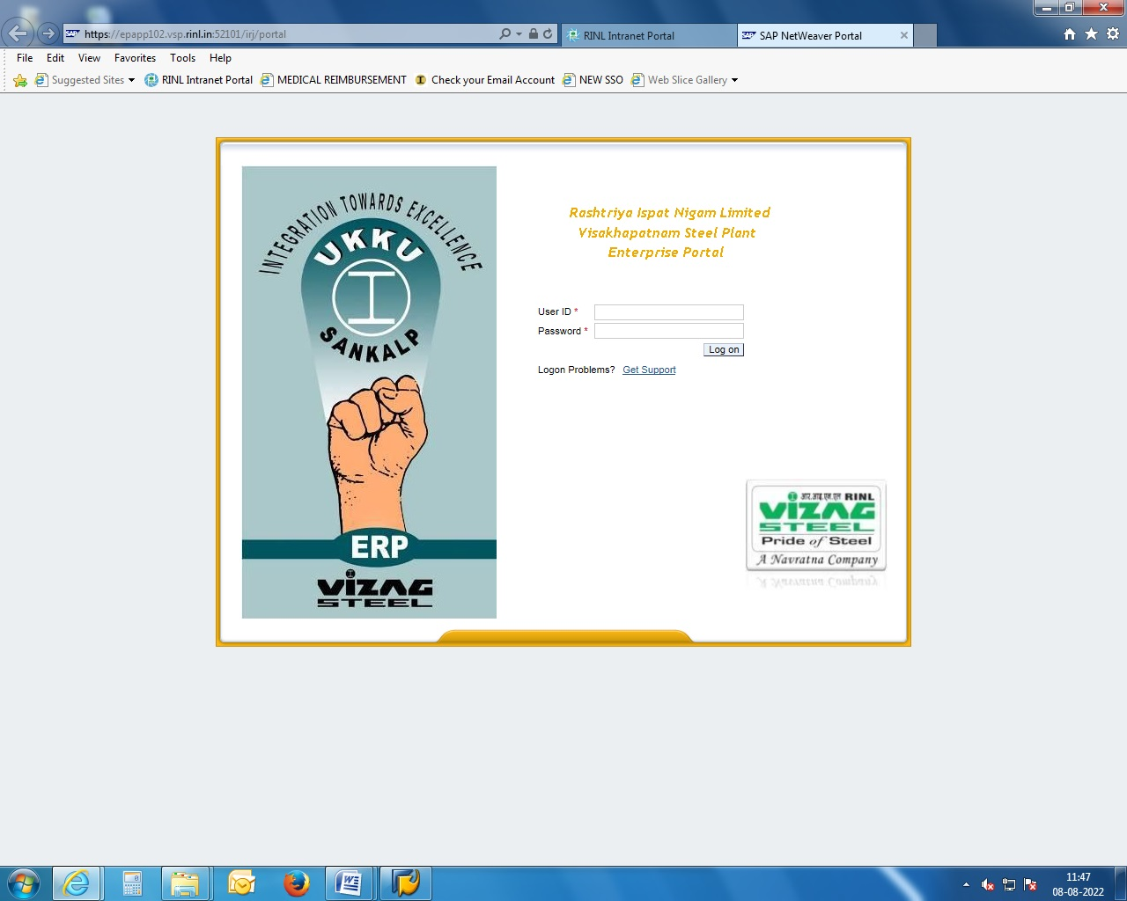
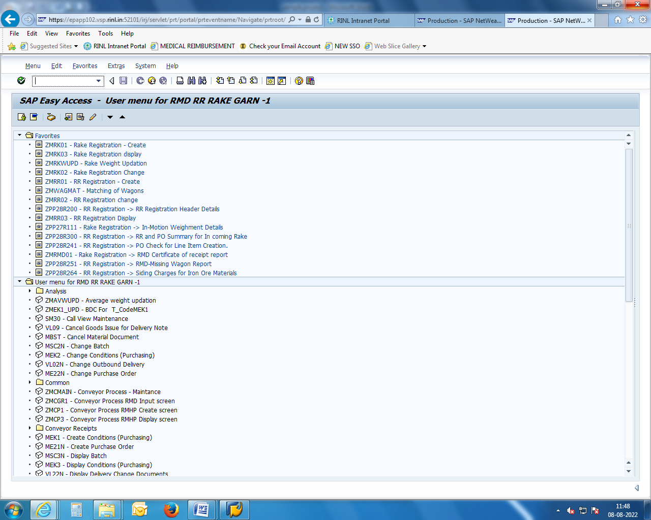
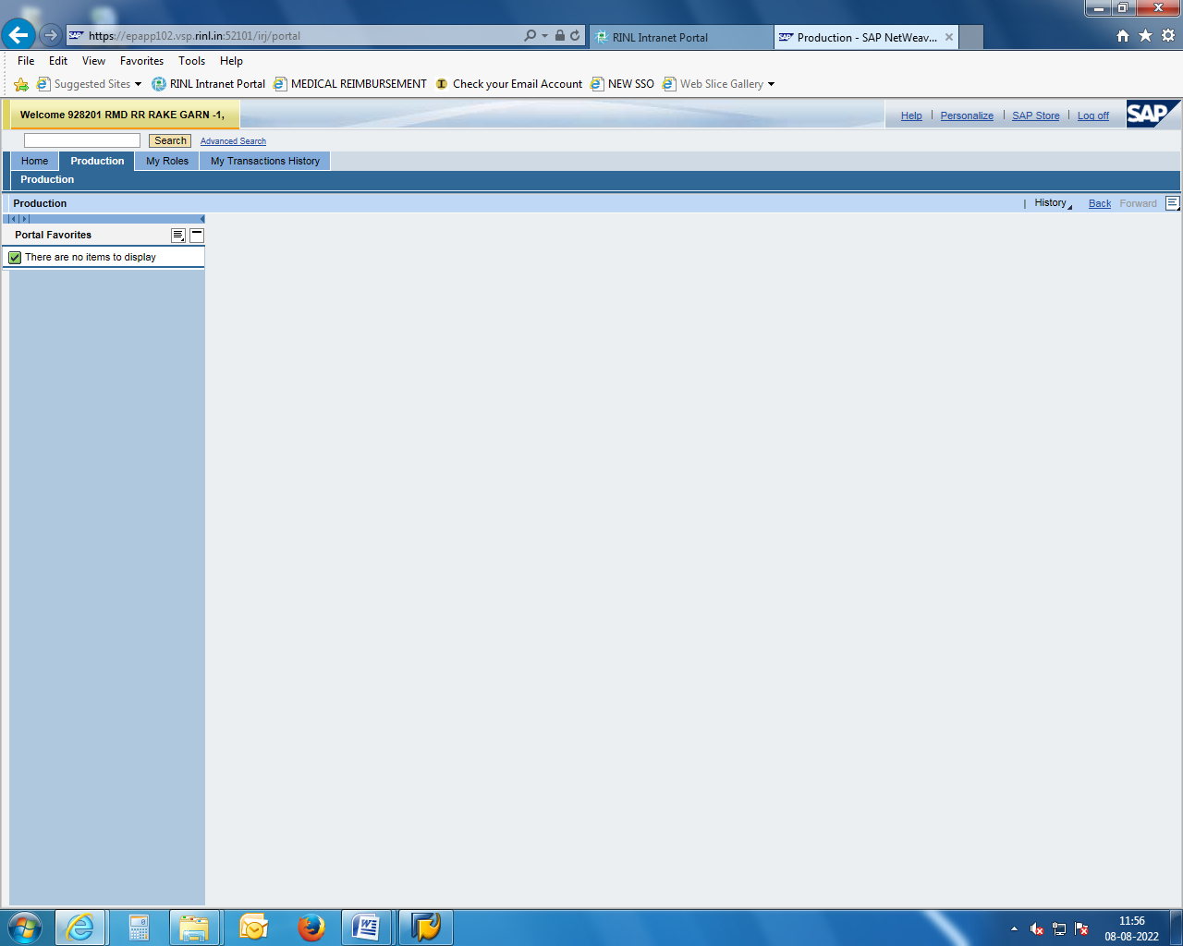
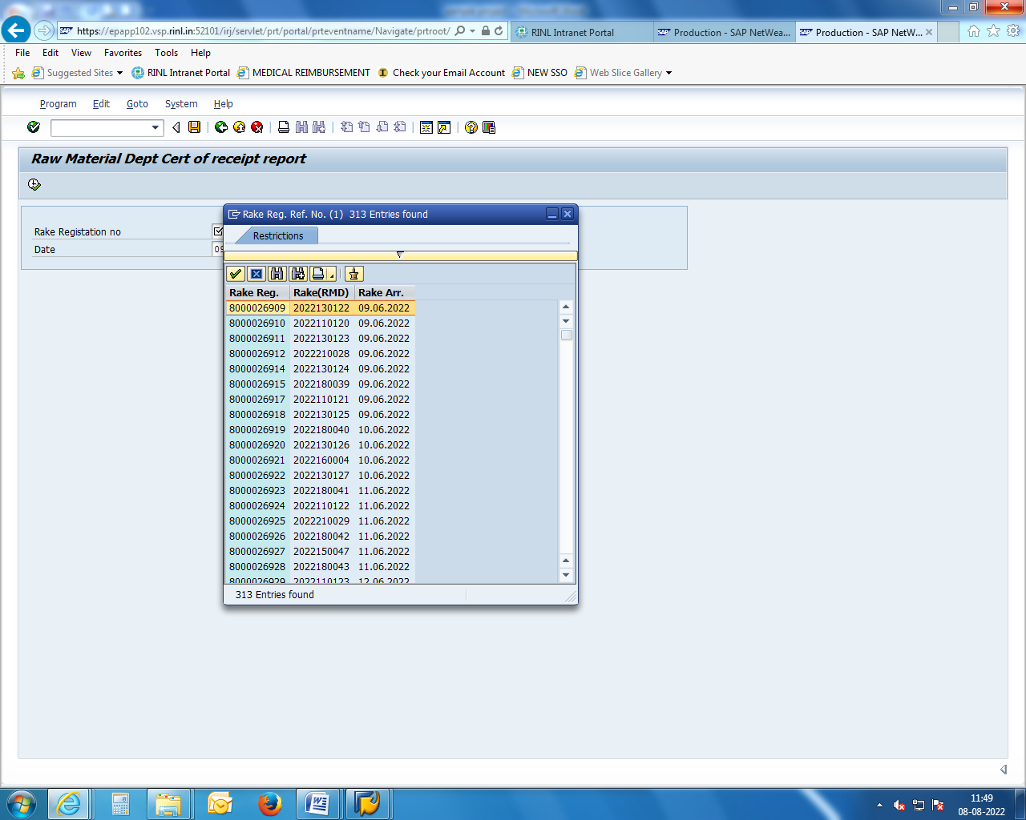
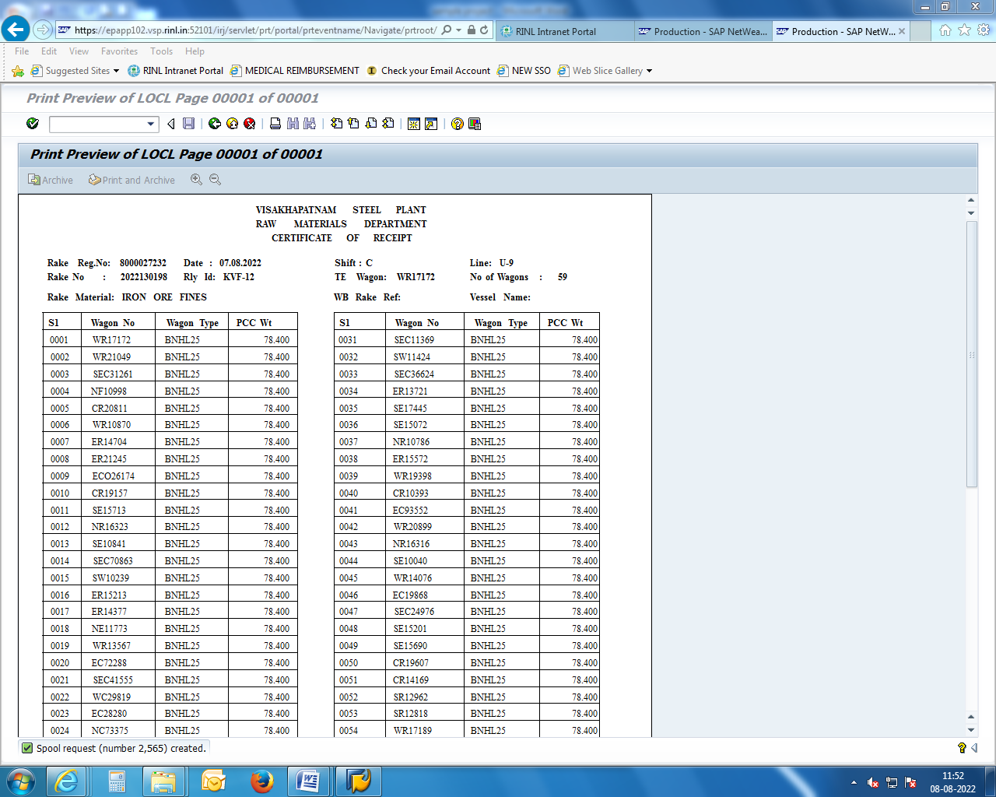
RAKE REGISTRATION & FEEDING (ERP-SAP)

Slide 16
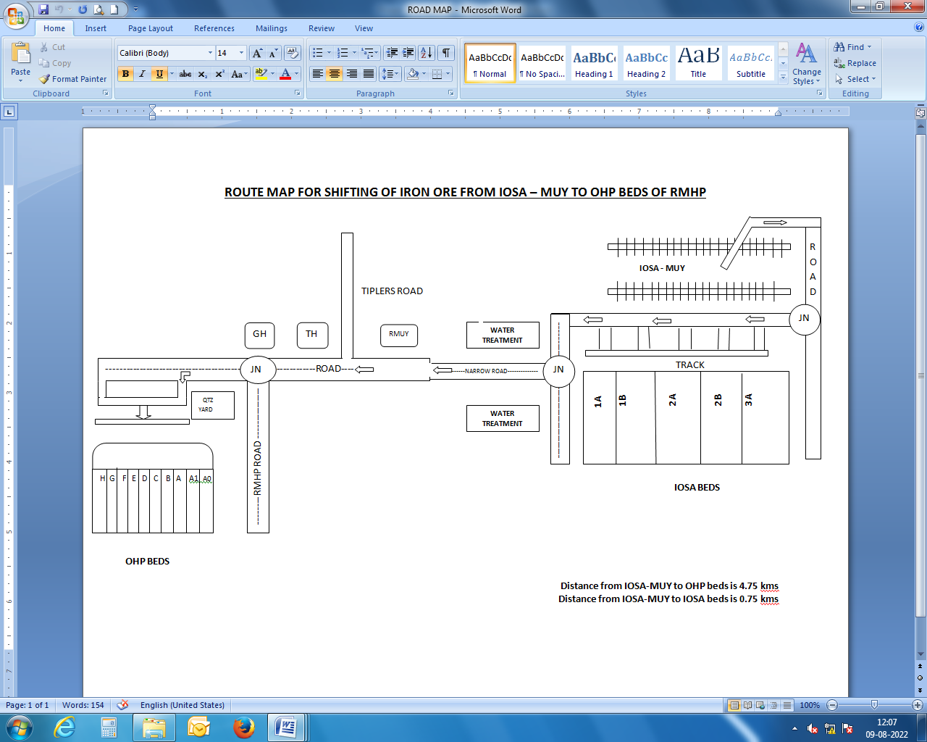
ROUTE MAP FOR SHIFTING OF IRON ORE FROM IOSA TO MUY – OHP BEDS

Slide 17
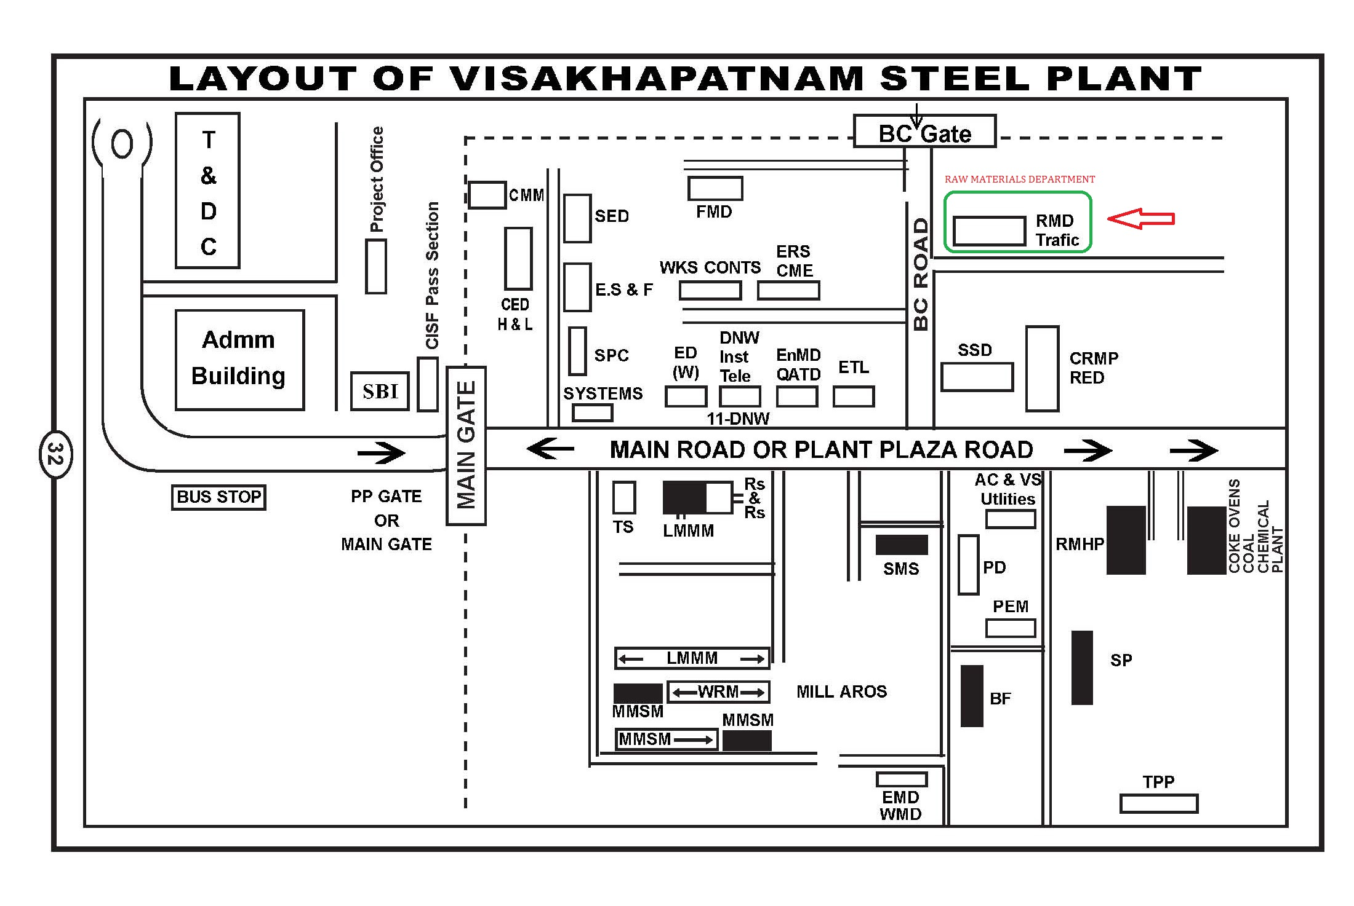

Slide 18
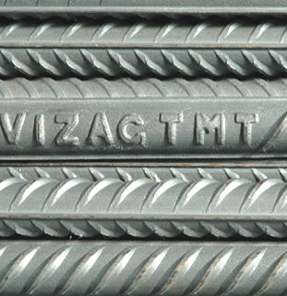
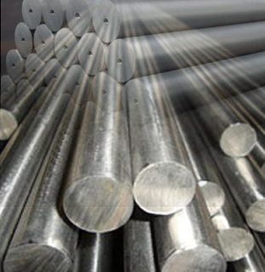
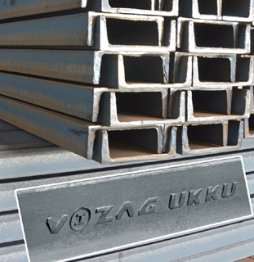
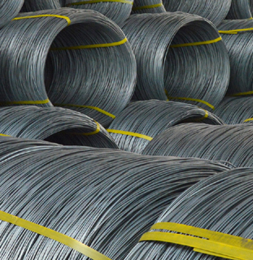
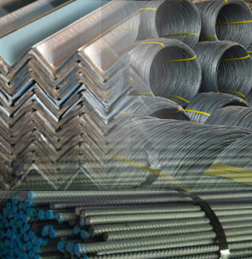
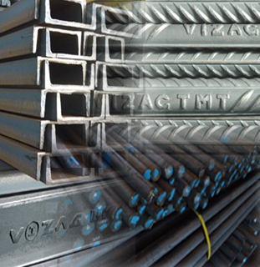
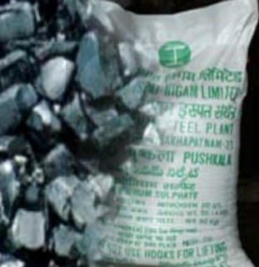
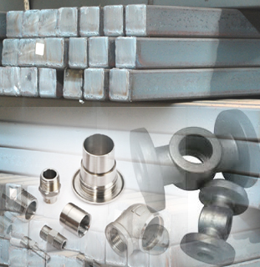
RINL - PRODUCTS
Rebars
Forged Rounds
Structurals
Wire Rod Coils
Exports
Prod mix
By prod
Special Steel

Slide 19
CONCLUSION
ACTIVITIES OF RAW MATERIALS DEPARTMENT
1. Indenting and Procuring of all raw materials required
for Process and Handled by RMHP.
2. Monitoring daily loading and Receipts of Raw materials.
3.Identification of bulk Raw Materials Received by Rail.
4.Accounting of all Raw materials.

Slide 20

THANK YOU
RASTHRIYA ISPAT NIGAM LIMITED - VISAKHAPATNAM

